Slide 1
Chapter 5
Elasticity and Its Application
Professor Galvez-Soriano lecture notes. Based on N. Gregory Mankiw, Principles of Microeconomics, 9th Edition.

Slide 2
The Elasticity of Demand
Elasticity
Measure of the responsiveness of quantity demanded or quantity supplied
To a change in one of its determinants
Price elasticity of demand
How much the quantity demanded of a good responds to a change in the price of that good
Professor Galvez-Soriano lecture notes. Based on N. Gregory Mankiw, Principles of Microeconomics, 9th Edition.

Slide 3
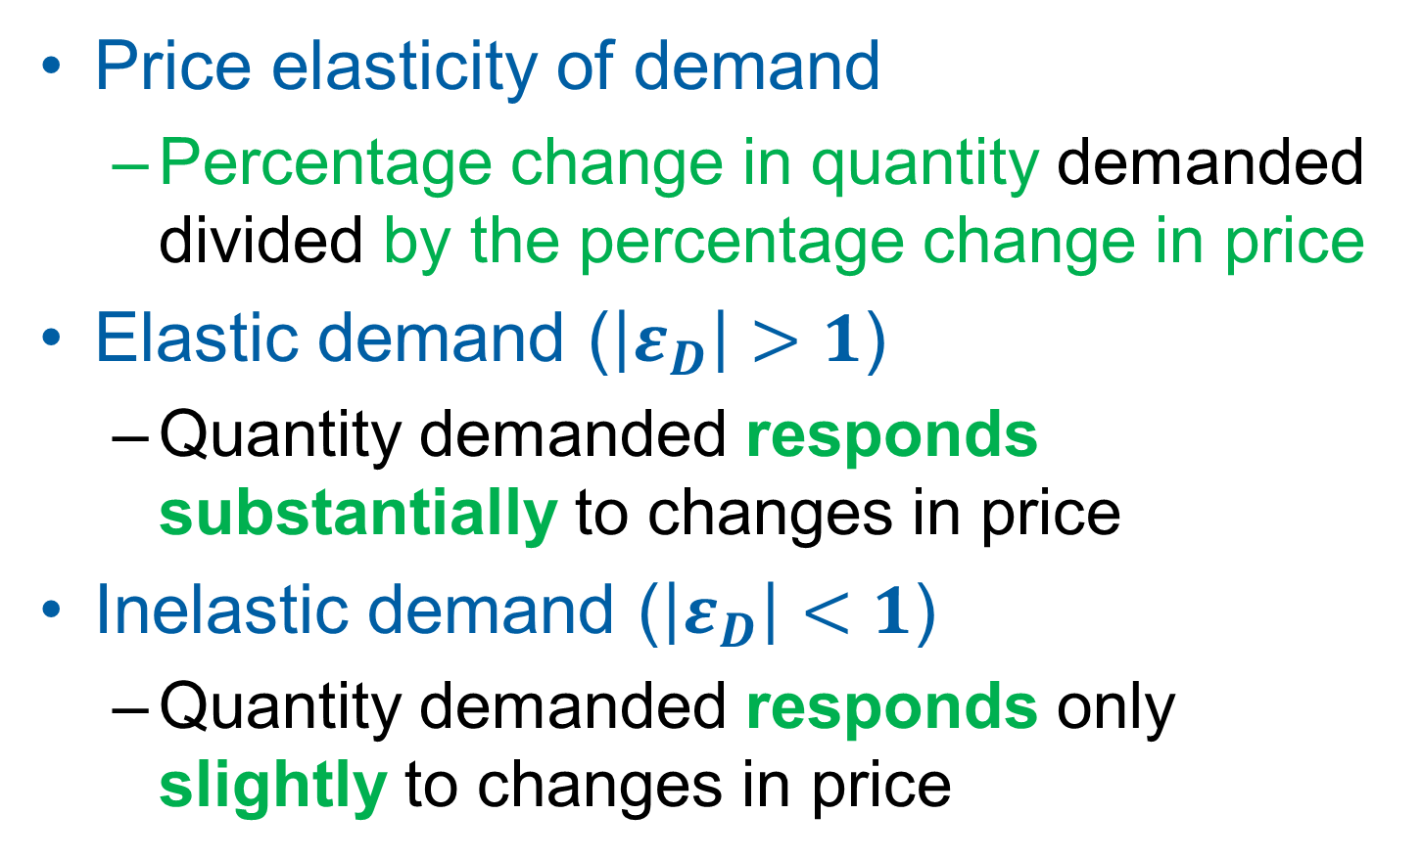
The Elasticity of Demand
Price elasticity of demand
Percentage change in quantity demanded divided by the percentage change in price
Elastic demand ($\left|ε_{D}\right|>1$)
Quantity demanded responds substantially to changes in price
Inelastic demand ($\left|ε_{D}\right|<1$)
Quantity demanded responds only slightly to changes in price
Professor Galvez-Soriano lecture notes. Based on N. Gregory Mankiw, Principles of Microeconomics, 9th Edition.

Slide 4
The Elasticity of Demand
Determinants of price elasticity of demand
Availability of close substitutes
Goods with close substitutes: more elastic demand
Necessities versus luxuries
Necessities: inelastic demand
Luxuries: elastic demand
Professor Galvez-Soriano lecture notes. Based on N. Gregory Mankiw, Principles of Microeconomics, 9th Edition.

Slide 5
The Elasticity of Demand
Determinants of price elasticity of demand
Definition of the market
Narrowly defined markets: more elastic demand
beverages – soda – Coke
Time horizon
Demand is more elastic over longer time horizons
Professor Galvez-Soriano lecture notes. Based on N. Gregory Mankiw, Principles of Microeconomics, 9th Edition.

Slide 6

The Elasticity of Demand
Computing the price elasticity of demand
Midpoint method
Two points: (Q₁, P₁) and (Q₂, P₂)
$$ε_{D}=\frac{(Q_{2}−Q_{1})/[(Q_{2}+Q_{1})/2]}{(P_{2}−P_{1})/[(P_{2}+P_{1})/2]}$$
Professor Galvez-Soriano lecture notes. Based on N. Gregory Mankiw, Principles of Microeconomics, 9th Edition.

Slide 7
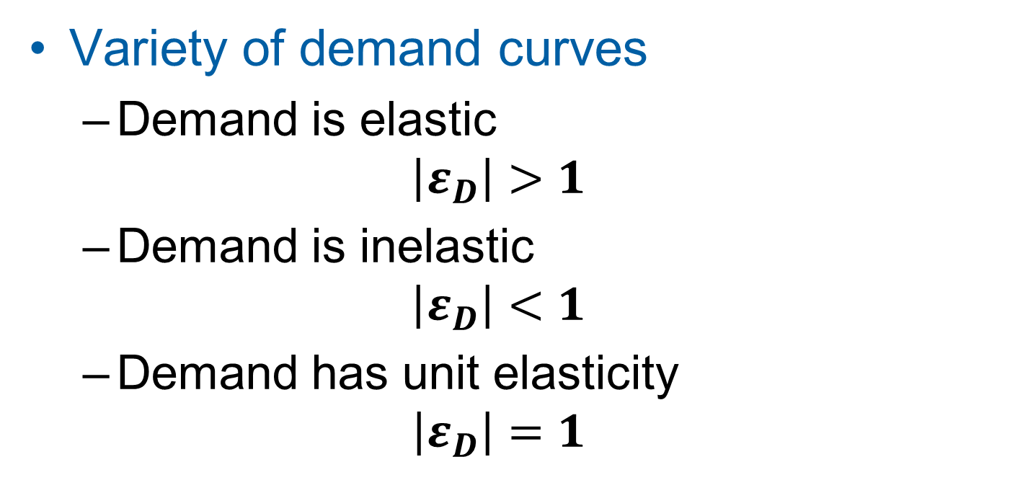
The Elasticity of Demand
Variety of demand curves
Demand is elastic
$$\left|ε_{D}\right|>1$$
Demand is inelastic
$$\left|ε_{D}\right|<1$$
Demand has unit elasticity
$$\left|ε_{D}\right|=1$$
Professor Galvez-Soriano lecture notes. Based on N. Gregory Mankiw, Principles of Microeconomics, 9th Edition.

Slide 8

Example
Suppose that during the past year, the price of a laptop rose from $2,100 to $2,230. During the same time period, consumer sales decreased from 406,000 to 254,000 laptops.
$$ε_{D}=\frac{(Q_{2}−Q_{1})/[(Q_{2}+Q_{1})/2]}{(P_{2}−P_{1})/[(P_{2}+P_{1})/2]}$$
 | Original | New | Average | Change | Percentage change
Quantity | 406,000 | 254,000 | 330,000 | -152,000 | -0.46
Price | 2,100 | 2,230 | 2,165 | 130 | 0.06
Professor Galvez-Soriano lecture notes. Based on N. Gregory Mankiw, Principles of Microeconomics, 9th Edition.

Slide 9
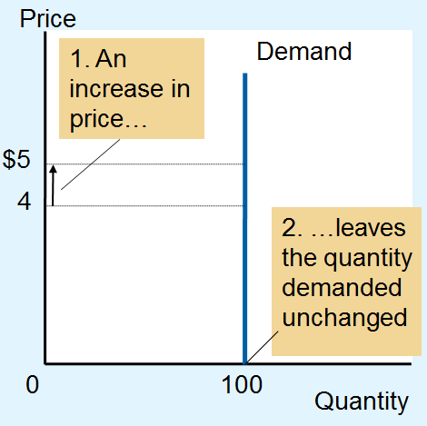
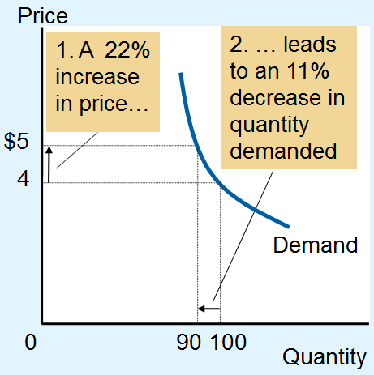
Figure 1 The Price Elasticity of Demand (a, b)
Perfectly Inelastic Demand:
Elasticity Equals 0
(b) Inelastic Demand: Elasticity Is Less Than 1
Professor Galvez-Soriano lecture notes. Based on N. Gregory Mankiw, Principles of Microeconomics, 9th Edition.

Slide 10
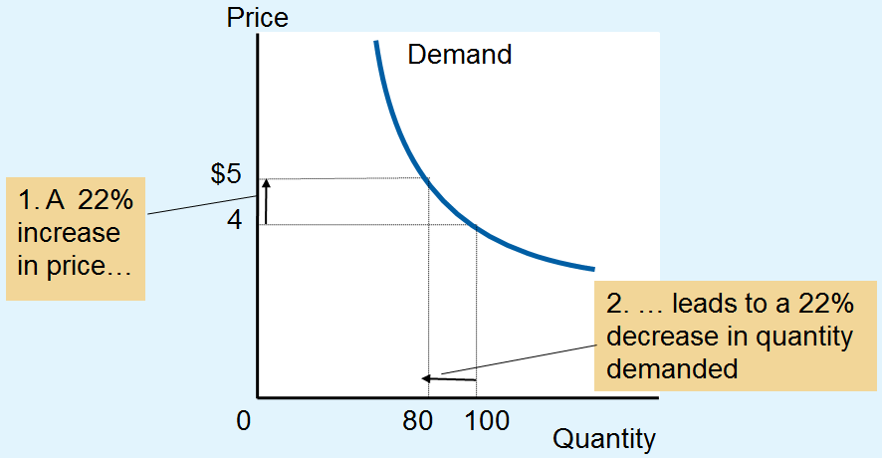
Figure 1 The Price Elasticity of Demand (c)
(c) Unit Elastic Demand: Elasticity Equals 1
Professor Galvez-Soriano lecture notes. Based on N. Gregory Mankiw, Principles of Microeconomics, 9th Edition.

Slide 11
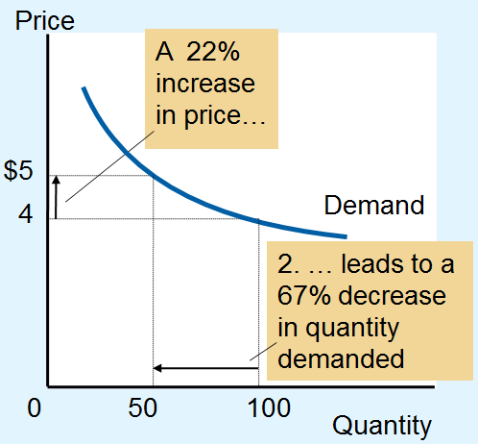
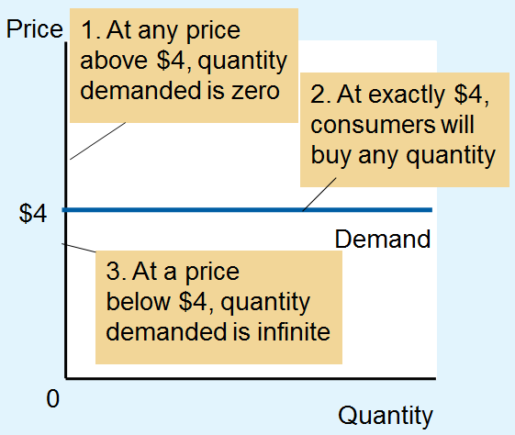
Figure 1 The Price Elasticity of Demand (d, e)
(d) Elastic demand:
Elasticity > 1
(e) Perfectly elastic demand:
Elasticity equals infinity
Professor Galvez-Soriano lecture notes. Based on N. Gregory Mankiw, Principles of Microeconomics, 9th Edition.

Slide 12
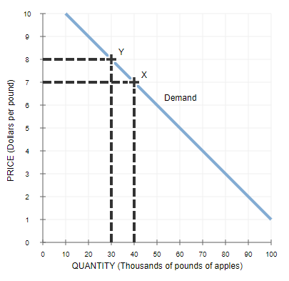
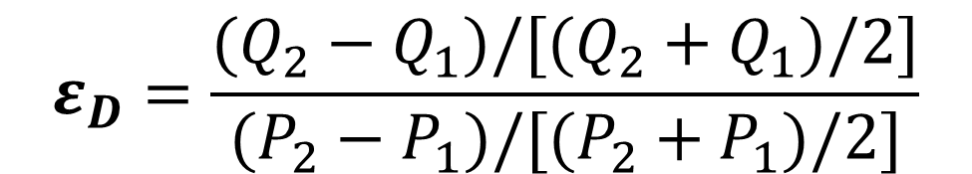
Example
 | Original | New | Average | Change | Percentage change
Quantity | 40 | 30 | 35 | -10 | -0.29
Price | 7 | 8 | 8 | 1 | 0.13
$$ε_{D}=\frac{(Q_{2}−Q_{1})/[(Q_{2}+Q_{1})/2]}{(P_{2}−P_{1})/[(P_{2}+P_{1})/2]}$$
Professor Galvez-Soriano lecture notes. Based on N. Gregory Mankiw, Principles of Microeconomics, 9th Edition.

Slide 13
The Elasticity of Demand
Total revenue, TR
Amount paid by buyers and received by sellers of a good
Price of the good times the quantity sold (P × Q)
For a price increase
If demand is inelastic, TR increases
If demand is elastic, TR decreases
Professor Galvez-Soriano lecture notes. Based on N. Gregory Mankiw, Principles of Microeconomics, 9th Edition.

Slide 14
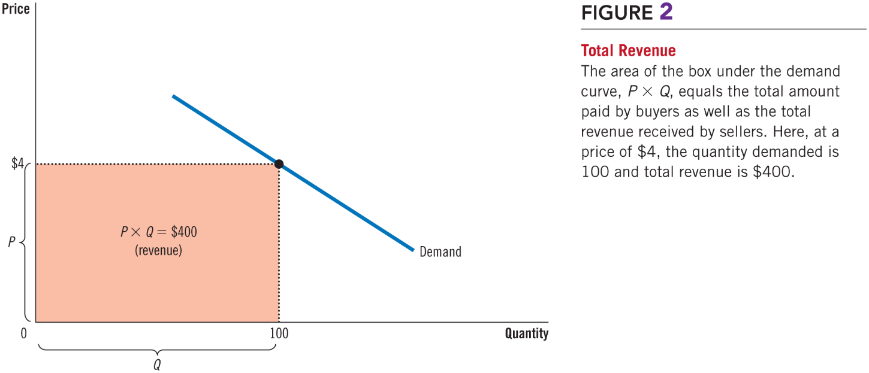
Figure 2 Total Revenue
Professor Galvez-Soriano lecture notes. Based on N. Gregory Mankiw, Principles of Microeconomics, 9th Edition.

Slide 15
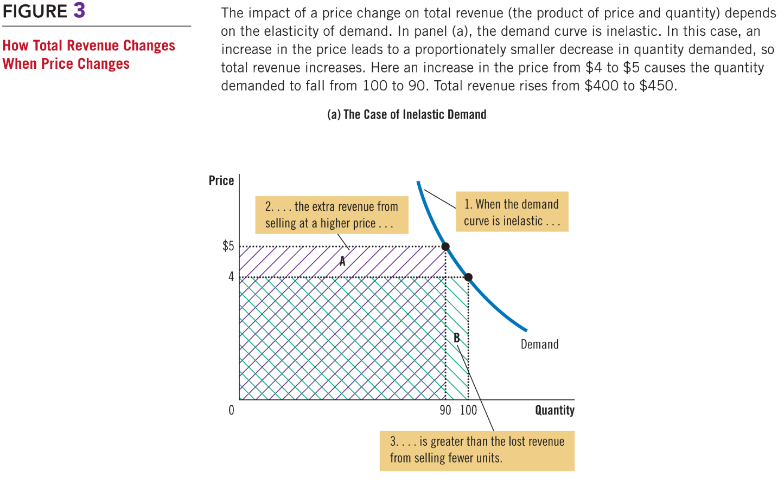
Figure 3 How Total Revenue Changes When Price Changes (a)
(a) The Case of Inelastic Demand
Professor Galvez-Soriano lecture notes. Based on N. Gregory Mankiw, Principles of Microeconomics, 9th Edition.

Slide 16
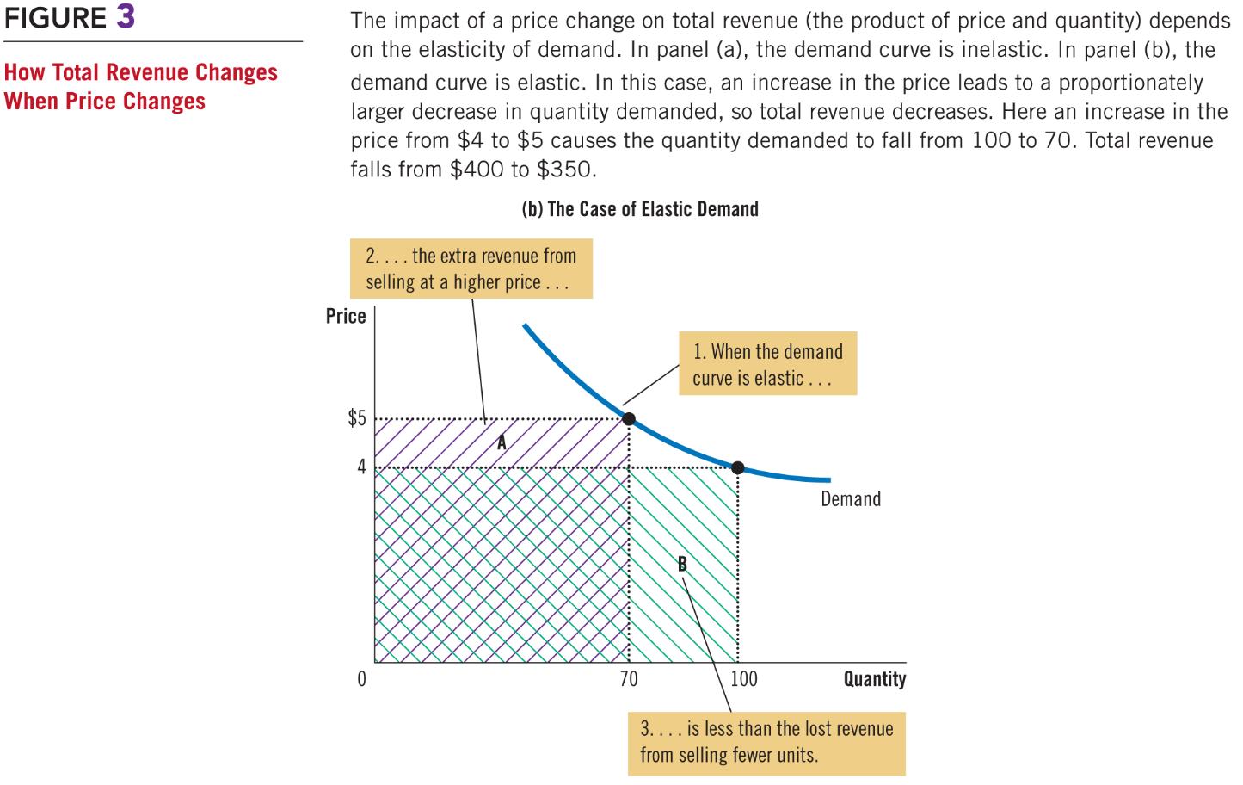
Figure 3 How Total Revenue Changes When Price Changes (b)
(b) The Case of Elastic Demand
Professor Galvez-Soriano lecture notes. Based on N. Gregory Mankiw, Principles of Microeconomics, 9th Edition.

Slide 17
The Elasticity of Demand
Linear demand curve
Constant slope
Different price elasticities
Professor Galvez-Soriano lecture notes. Based on N. Gregory Mankiw, Principles of Microeconomics, 9th Edition.

Slide 18
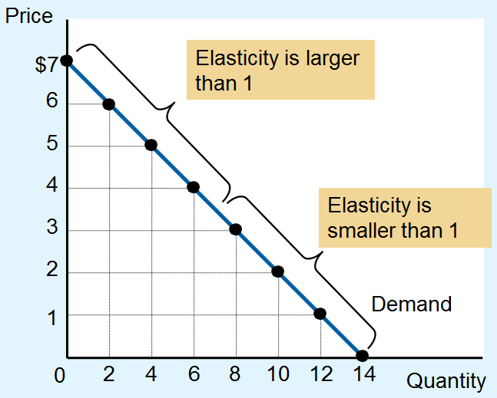
Figure 4 Elasticity along a Linear Demand Curve
The slope of a linear demand curve is constant, but its elasticity is not.
Professor Galvez-Soriano lecture notes. Based on N. Gregory Mankiw, Principles of Microeconomics, 9th Edition.

Slide 19
Figure 4 Elasticity along a Linear Demand Curve
Price | Quantity | Total Revenue (Price x Quantity) | Percentage Change in Price | Percentage Change in Quantity | Elasticity | Description
$7 | 0 | $0 | 15 | 200 | 13.0 | Elastic
6 | 2 | 12 | 18 | 67 | 3.7 | Elastic
5 | 4 | 20 | 22 | 40 | 1.8 | Elastic
4 | 6 | 24 | 29 | 29 | 1.0 | Unit elastic
3 | 8 | 24 | 40 | 22 | 0.6 | Inelastic
2 | 10 | 20 | 67 | 18 | 0.3 | Inelastic
1 | 12 | 12 | 200 | 15 | 0.1 | Inelastic
0 | 14 | 0
Professor Galvez-Soriano lecture notes. Based on N. Gregory Mankiw, Principles of Microeconomics, 9th Edition.

Slide 20
The Elasticity of Demand
Income elasticity of demand
How much the quantity demanded of a good responds to a change in consumers’ income
Professor Galvez-Soriano lecture notes. Based on N. Gregory Mankiw, Principles of Microeconomics, 9th Edition.

Slide 21
The Elasticity of Demand
Normal goods
Positive income elasticity
Necessities
Smaller income elasticities
Luxuries
Large income elasticities
Inferior goods
Negative income elasticities
Professor Galvez-Soriano lecture notes. Based on N. Gregory Mankiw, Principles of Microeconomics, 9th Edition.

Slide 22
The Elasticity of Demand
Cross-price elasticity of demand
How much the quantity demanded of one good responds to a change in the price of another good
Professor Galvez-Soriano lecture notes. Based on N. Gregory Mankiw, Principles of Microeconomics, 9th Edition.

Slide 23
The Elasticity of Demand
Substitutes
Goods typically used in place of one another
Positive cross-price elasticity
Complements
Goods that are typically used together
Negative cross-price elasticity
Professor Galvez-Soriano lecture notes. Based on N. Gregory Mankiw, Principles of Microeconomics, 9th Edition.

Slide 24
The Elasticity of Supply
Price elasticity of supply
How much the quantity supplied of a good responds to a change in the price of that good
Depends on the flexibility of sellers to change the amount of the good they produce
Professor Galvez-Soriano lecture notes. Based on N. Gregory Mankiw, Principles of Microeconomics, 9th Edition.

Slide 25
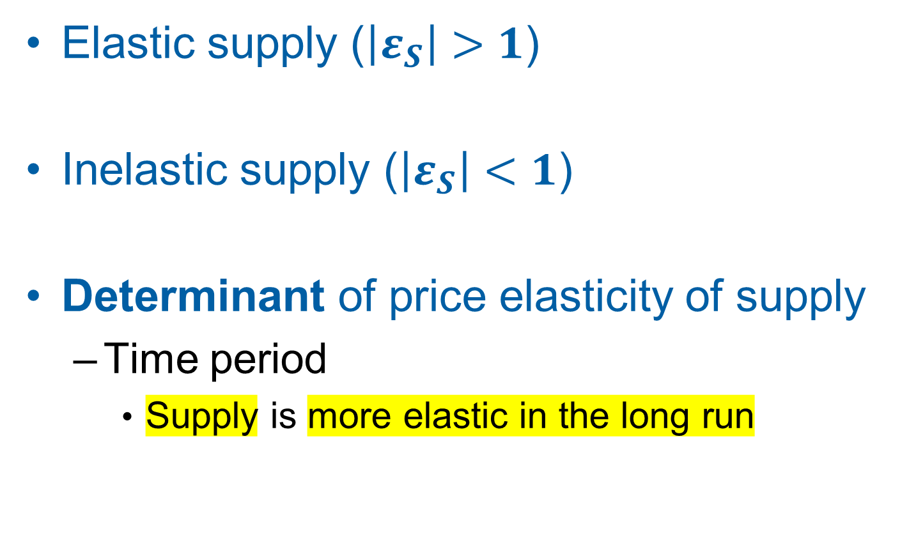
The Elasticity of Supply
Elastic supply ($\left|ε_{S}\right|>1$)
Inelastic supply ($\left|ε_{S}\right|<1$)
Determinant of price elasticity of supply
Time period
Supply is more elastic in the long run
Professor Galvez-Soriano lecture notes. Based on N. Gregory Mankiw, Principles of Microeconomics, 9th Edition.

Slide 26

The Elasticity of Supply, Part 3
Computing price elasticity of supply
Midpoint method
Two points: (Q₁, P₁) and (Q₂, P₂)
$$ε_{S}=\frac{(Q_{2}−Q_{1})/[(Q_{2}+Q_{1})/2]}{(P_{2}−P_{1})/[(P_{2}+P_{1})/2]}$$
Professor Galvez-Soriano lecture notes. Based on N. Gregory Mankiw, Principles of Microeconomics, 9th Edition.

Slide 27
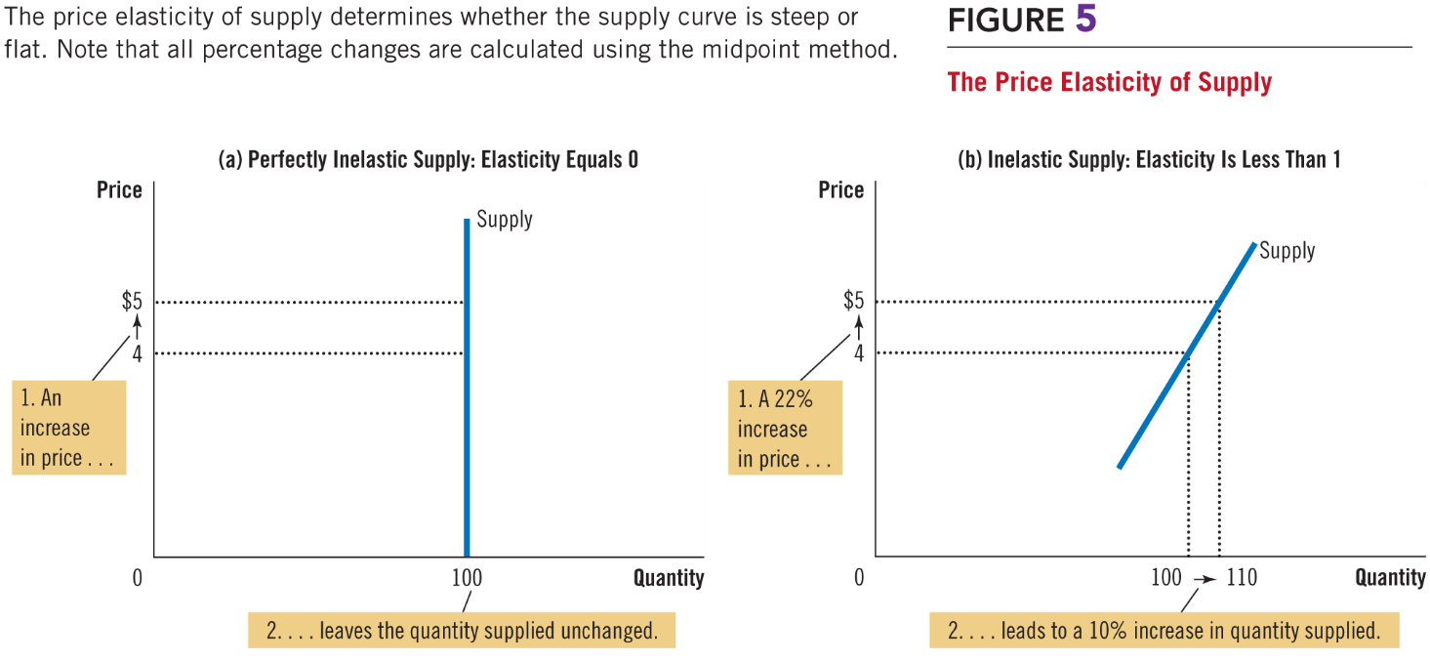
Figure 5 The Price Elasticity of Supply (a, b)
Professor Galvez-Soriano lecture notes. Based on N. Gregory Mankiw, Principles of Microeconomics, 9th Edition.

Slide 28
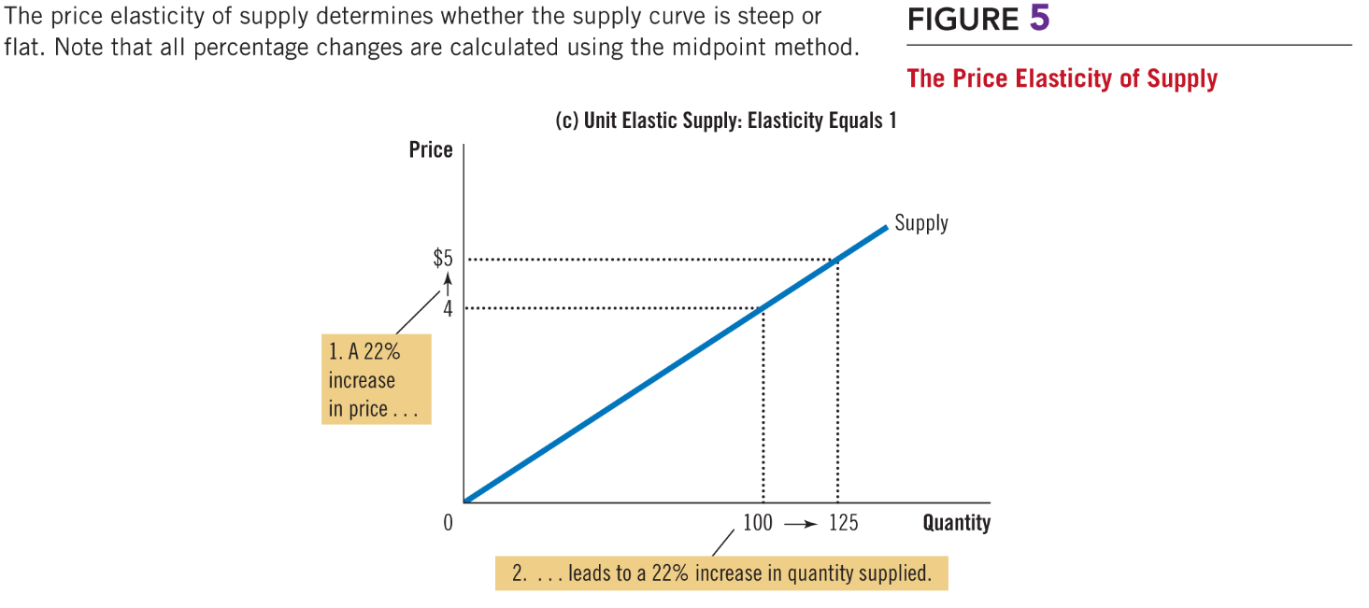
Figure 5 The Price Elasticity of Supply (c)
Professor Galvez-Soriano lecture notes. Based on N. Gregory Mankiw, Principles of Microeconomics, 9th Edition.

Slide 29
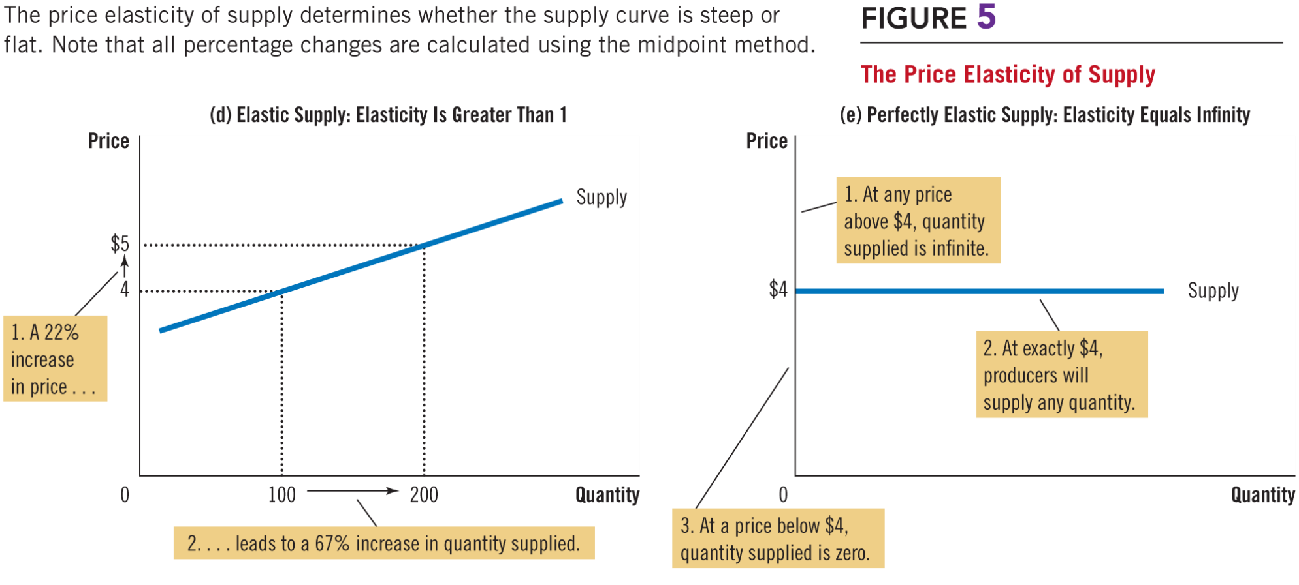
Figure 5 The Price Elasticity of Supply (d, e)
Professor Galvez-Soriano lecture notes. Based on N. Gregory Mankiw, Principles of Microeconomics, 9th Edition.

Slide 30
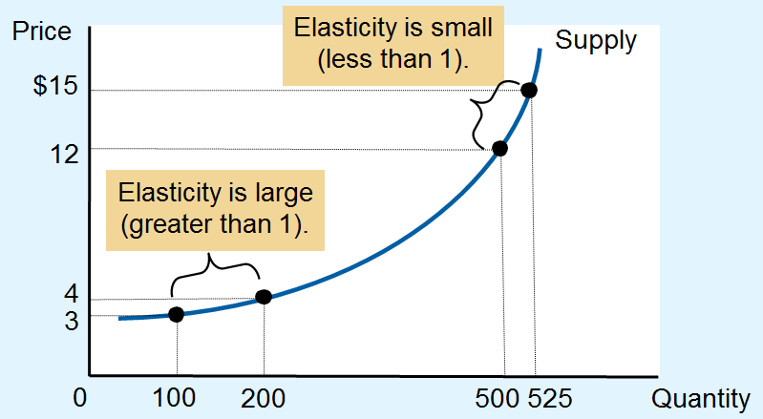
Figure 6 How the Price Elasticity of Supply Can Vary
Professor Galvez-Soriano lecture notes. Based on N. Gregory Mankiw, Principles of Microeconomics, 9th Edition.
Notes:
For high levels of quantity supplied where firms have reached near maximum capacity, supply becomes less elastic because firms may need to invest in additional capital in order to increase production further.

